Slide 1
George Washington
Thomas Jefferson
Abraham
Lincoln
Theodore
Roosevelt

Slide 2
Mount Rushmore Facts
The carving started in 1927 and finished in 1941—few injuries but no deaths.
They stand at over 5,500 feet
Each president’s head is as tall as a 6 story building
Over 800 million pounds of stone were removed during the construction

Slide 3
George Washington
Born on February 22, 1732
Died on December 14, 1799
Died at Bridges Creek Plantation
His father died when he was 11 yr old
He had two half brothers that were older then him and three younger brothers.

Slide 4
GW Just the facts
He had no formal education.
Is the only president elected unanimously.
At his inauguration, he had only one tooth.
Stood 6 feet and 2 inches tall, weighed 200 pounds and wore size 13 shoes.
Is the only president who didn't live in Washington, D.C. during his presidency.

Slide 5
Cherry Tree Story
The story of George Washington chopping down the cherry is one of the most famous stories told about Washington. There is no evidence that the story was true. Some say the story was told in order to point out George Washington's honesty.

Slide 6
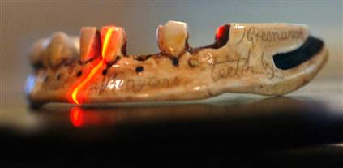
False Teeth NOT wooden
Laser scans showed that they were made up of gold, ivory, lead, human and animal teeth

Slide 7
Abraham Lincoln
He was the first president born out of the 13 original colonies
Was born on February 12, 1809 in Hodgenville, Kentucky.
Lincoln had one sister, Sarah, who was 2 years older and a brother who died in infancy

Slide 8
Lincoln Interesting Facts When he was a little boy he almost drowned in Knob’s Creek but was saved by a neighbor boy He was afraid of dentist because one broke off part of his jawbone by pulling a tooth. He was 6’4” while most men in the US were onlyl 5”6”and wore a size 14 shoe He was also colorblind He is the only US President with a patent. He had an idea that would help boats float over sandbars.

Slide 9
Lincoln & Kennedy Facts
Abraham Lincoln was elected to Congress in 1846. John F. Kennedy was elected to Congress in 1946.
Abraham Lincoln was elected President in 1860. John F. Kennedy was elected President in 1960.
Both were particularly concerned with civil rights. Both wives lost their children while living in the White House.
Both Presidents were shot on a Friday.
Both Presidents were shot in the head.

Slide 10
Lincoln & Kennedy Part II
Lincoln's secretary was named Kennedy. Kennedy's Secretary was named Lincoln. Both were assassinated by Southerners. Both were succeeded by Southerners named Johnson. Andrew Johnson, who succeeded Lincoln, was born in 1808. Lyndon Johnson, who succeeded Kennedy, was born in 1908.
John Wilkes Booth, who assassinated Lincoln, was born in 1839. Lee Harvey Oswald, who assassinated Kennedy, was born in 1939.

Slide 11
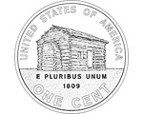
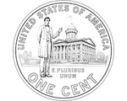
200th Anniversary
Birth As a young
Place Boy
Illinois US Capitol
State Dome
Capitol

Slide 12
This powerpoint was kindly donated to www.worldofteaching.com
http://www.worldofteaching.com is home to over a thousand powerpoints submitted by teachers. This is a completely free site and requires no registration. Please visit and I hope it will help in your teaching.

